Slide 1
Cardiac Output Monitor Survey The impact of NICE guidance and CQUIN payments on Cardiac Output Monitors in the NHS: A trainee led national survey
Claire Allen
ST5 Anaesthesia
12th Feb 2015

Slide 2
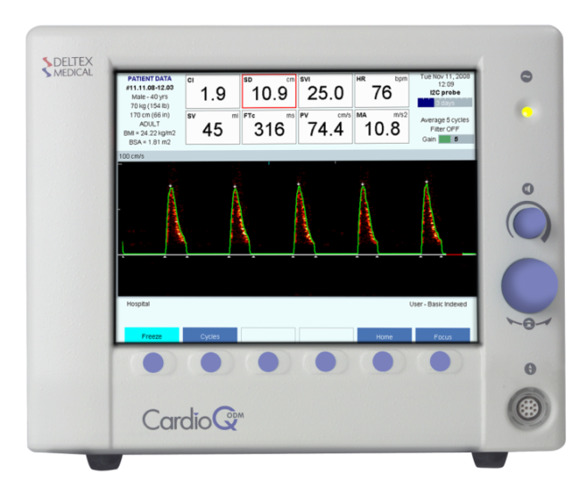
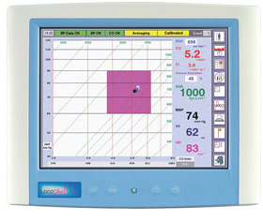
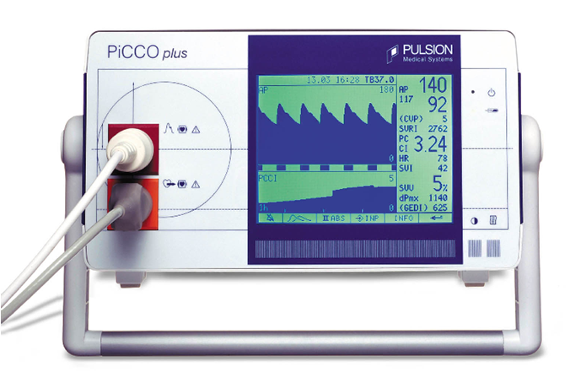
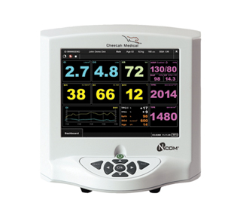
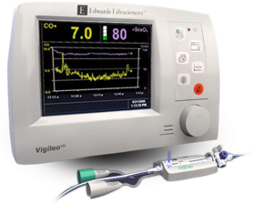

Slide 4
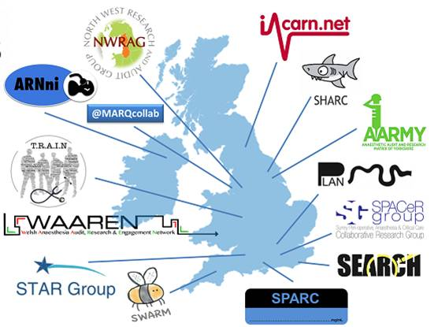

Slide 5
Aims
Describe the current use of cardiac output monitors
Determine the effect of NICE guidance and CQUIN payment schemes
Test the ability of RAFT to undertake a comprehensive survey

Slide 6
Methods
Prospective survey
Open to trusts in network
Two week period from 30th June 2014
Questionnaire completed at local sites
Semi-structured interview
Count of COMs
Review of local policies
Data centralisation

Slide 7
My Role
Regional lead on behalf of NWRAG
Recruit site leads
Coordinate regional data collection
Collate and upload regional data
Perform regional data analysis
Local lead at one site

Slide 8
Possession of COMs
 | National | North West
No. of sites with COMs | 66/67 (99%) | 9/9 (100%)
Mean no. of COMs per site | 7 (Range 0-29) | 4.8 (Range 2-16)
Percentage of COM by type – North West and National
ODM – CardioQ Oesophageal Doppler Monitor

Slide 9
Year of COM procurement in North West
No of COMs

Slide 10
Reason for COM purchase
%
 | National | North West
CQUIN for Intraoperative fluid management | 34% | 33%

Slide 11
COMs purchased due to NICE
%

Slide 12
COMs purchased due to CQUIN
%

Slide 13
Support structures for COMs
Rise in procurement in 2011
 | % rise in procurement
All COMs | 25%
ODM | 29%
Lidco Rapid | 63%
 | National | North West
% Sites with local COM guideline | 44% | 33%
% Sites with formal COM training | 56% | 67%

Slide 14
Discussion
Limitations to study
Limited representation of NHS
Survey responses based on opinion
Missing data
Examined procurement rather than usage
NICE guidance and CQUIN payments have affected monitor uptake.
Wide range of monitors in use
Many sites lack formal training and guidelines

Slide 15
Conclusions
RAFT conducted a comprehensive survey
COM ownership widespread
CardioQ ODM most popular
Commonest reason for purchase was clinical opinion

Slide 16
Acknowledgements
RAFT committee
Local contributors (http://www.raftrainees.com/contributors.html)
NWRAG committee
Dr Daniel Conway CMFT
References
http://www.england.nhs.uk/wp-content/uploads/2013/02/cquin-guidance.pdf
http://webarchive.nationalarchives.gov.uk/20130701143131/http:/ntac.nhs.uk/web/files/intra_operative_fluid_management/iofm_adoption_pack_update_jan_2013.pdf
NICE (2011) CardioQ-ODM (oesophageal Doppler monitor) (MTG3)
NICE (2012) Oesophageal Doppler-guided fluid management during major surgery: reducing post-operative complications and bed days.

Slide 17
Question stem | Answer options
Collaborative name | Free text
Trust codes | Free text
Trust type | Foundation Trust, non-Foundation Trust
Hospital type | University hospital vs District General Hospital
Bed number | <500, 500-1000, >1000
Has your trust had an intra-operative fluid management pre-requisite CQUIN?: | Yes, No
What was the CQUIN start date? | Free text
How long did the CQUIN apply? | Free text
What were the terms of the CQUIN? | Free text
Did the CQUIN define specific cases requiring COM usage? | Yes, No
What were these cases? | Free text
Specifically, did these include high-risk emergency laparotomies? | Yes, No
What % of these cases needed a COM to be CQUIN compliant? | Free text
How was COM usage practically measured? (eg WHO checklist, theatre management system, not recorded) | Free text
How many COMs exist in your anaesthetic department (NOT ICU)? | Free text
What are these COMs (include any labeled as such), when were they purchased and why? | COM type, Number of this type, Purchase date, Purchased for CQUIN; Yes / No, Purchased following NICE guidance; Yes / No
For COMs NOT purchased for CQUIN / NICE, why were they? | Free text
Does your department have a local guideline for COM use? | Yes,/ No
Does this guideline include an algorithm? (please email if able) | Yes/ No
Does it recommend use of crystalloid or colloid? | Free text
When was this guideline introduced? | Free text
Do individual anaesthetists undergo training prior to using COMs? | Yes, No
How is training monitored / recorded? | Free text
Do you have free access to disposables? | Yes, No

Slide 18
Number of local sites per regional group
Total = 67 Sites
NWRAG

